Slide 1

AEROSPACE MATERIALS INFORMATICS
Informatics-Driven
Inverse Design of
High-Performance Polymers
Optimizing Polyimide, PEEK, and PTFE for LEO Satellite Shielding
A Comprehensive QSPR Pipeline for Thermal Endurance & Dielectric Stability
BL.AI.U4AID25046
BL.AI.U4AID25062
BL.AI.U4AID25054

Slide 2
PROJECT OVERVIEW
Project Objective
The Problem
The Primary Goal
Current aerospace polymers force a fundamental compromise between extreme thermal survivability and signal clarity (dielectric constant) in Low Earth Orbit (LEO) environments.
Develop a fully automated, ML-driven pipeline that breaks this compromise by computationally designing novel, optimized variations of Polyimide, PEEK, and PTFE.
Key Performance Targets
Thermal Endurance
Dielectric Optimization
Strictly maintain or exceed baseline thermal performance: Tg ≥ 300.0°C for Polyimide
Minimize Dielectric Constant toward target: Dk ≤ 3.50 to reduce satellite signal degradation
The Methodology
Combine Multi-Target QSPR predictive modeling with RDKit-based structural inverse design to mathematically generate and validate new chemical candidates before physical synthesis .

Slide 3
OPERATIONAL CONTEXT
The LEO Satellite Shielding Challenge
The Environment
The Signal Problem
The Polymer Compromise
Satellites in Low Earth Orbit face extreme thermal cycling, high solar radiation, and the vacuum of space.
Shielding materials must protect hardware without blocking or distorting critical high-frequency communication signals.
Current polymers either have high heat resistance but poor signal transmission, or excellent signal properties but low thermal endurance.
-150°C to +120°C
UV Radiation
1-40 GHz
Low Loss
Trade-off
No Ideal Material
The Solution: Inverse Design
Use Machine Learning and chemical informatics to "inverse design" custom polymer variations tailored specifically for space applications.
240
184
3
2
Samples/Polymer
Features
Polymers
Targets

Slide 4
DATA FOUNDATION
Foundational Data & Feature Engineering
Dataset Scale
Feature Categories
Comprehensive morphological sampling
01
Structural Descriptors
40
720
184
Total Samples
Features/Sample
02
Latent Dimensions
40
240 × 3 polymers
Pre-optimization
03
Physics/Morphological
40
04
Morgan Fingerprints
64
Structural
Latent
Physics
Morgan
RDKit molecular descriptors capturing topology, bonding, and electronic properties.
polyBERT vector embeddings representing learned chemical sequence representations.
Morphological limits including crystallinity, free volume, and chain rigidity.
ECFP4 circular fingerprints (radius=2) mapping local chemical bond environments.
FVF
Cryst%
Rigidity
MolWt
Rings
TPSA
LogP
40-dim
Embedding
Contextual
ECFP4
64-bit
R=2

Slide 5
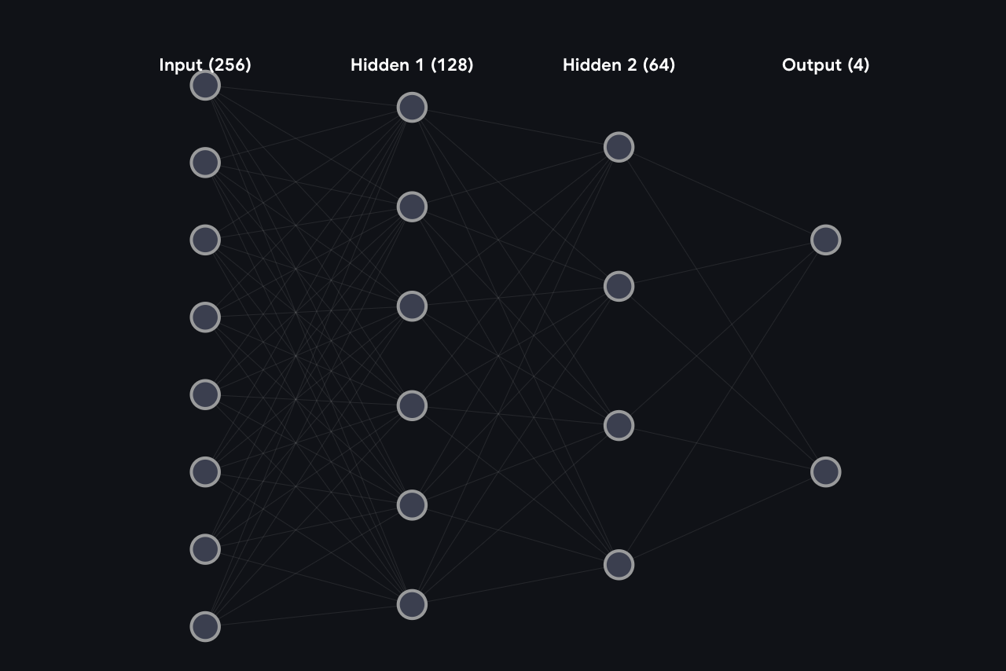
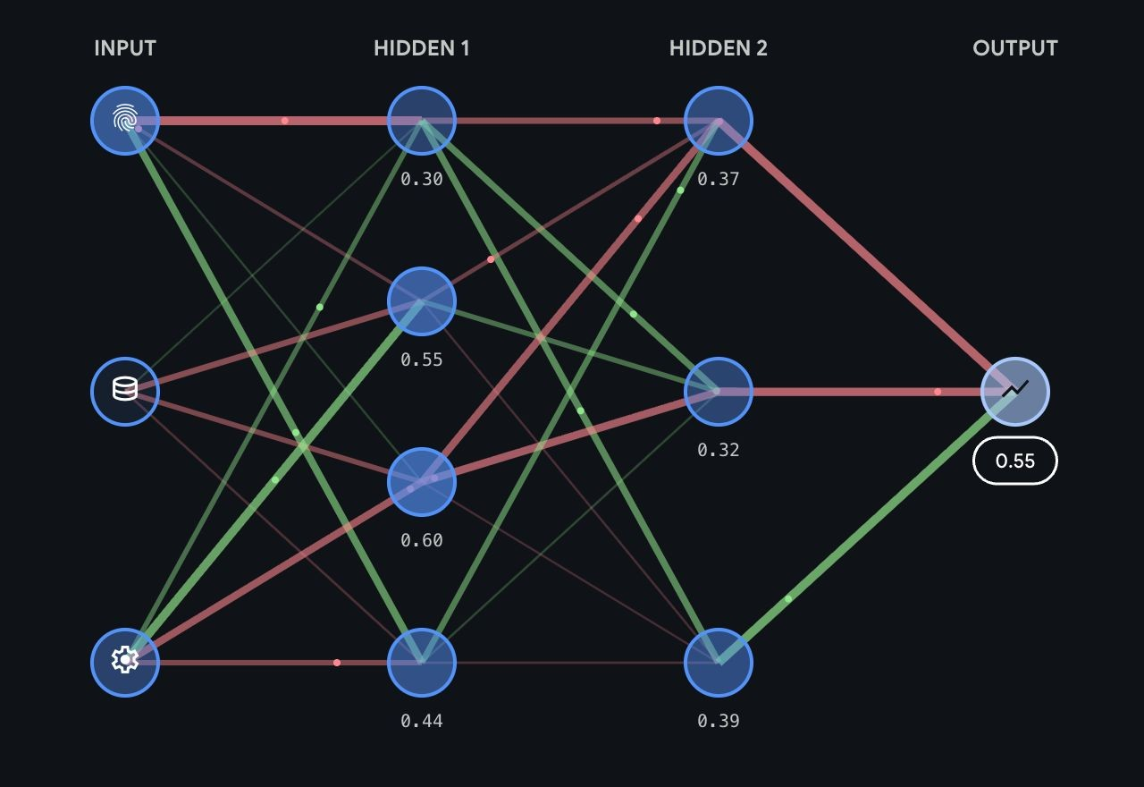
MACHINE LEARNING CORE
The Predictive QSPR Engine
Model Architecture
Training Configuration
Input Layer
120 features
Train/Test Split
Solver
80/20
Adam
Hidden Layer 1
256 neurons
Activation
Max Iterations
ReLU
600
Hidden Layer 2
128 neurons
Hidden Layer 3
64 neurons
Output Layer
4 targets

Slide 6
PARADIGM SHIFT
Transitioning to Structural Inverse Design
Traditional QSPR
Inverse Design
1
Input: Known molecular structure (SMILES)
1
Input: Desired performance targets
2
Process: Extract features, feed to model
2
Process: Algorithm generates candidates
3
Output: Predicted properties
3
Output: Novel molecular structure
"Given this molecule, what are its properties?"
"Given these targets, what molecule should I create?"
Base Input
Output Goal
Computational Engine
Pipeline starts with known SMILES strings of base polymers.
Generate novel mutated SMILES that improve upon original polymer's weaknesses.
Powered by RDKit, the industry standard for chemical informatics.
Polyimide: O=C1c2cc...
Better dielectric constant
Molecular manipulation
PEEK: c1ccc(Oc2...
Maintained thermal stability
Reaction simulation
PTFE: FC(F)(F)C...
Synthetically accessible
Descriptor calculation

Slide 7
CHEMICAL INFORMATICS
The RDKit Mutation Engine
Mutation Strategy
The algorithm automatically applies specific chemical reactions to the base polymer's aromatic rings, generating structurally valid derivatives with predictable property modifications.
F
Fluorination
CF₃
Trifluoromethylation
Reduces dielectric constant
Strong dielectric reduction
[cH1:1]>>[c:1](F)
[cH1:1]>>[c:1](C(F)(F)F)
Replaces hydrogen with Fluorine atom, increasing electronegativity and reducing polarizability.
Adds CF₃ group for maximum dielectric constant reduction while maintaining thermal stability.
CH₃
Methylation
Cl
Chlorination
Moderate property tuning
Alternative halogenation
[cH1:1]>>[c:1](C)
[cH1:1]>>[c:1](Cl)
Adds methyl group for subtle property modifications and steric effects.
Replaces hydrogen with Chlorine, offering different electronic effects than fluorine.
Batch Generation
50
Balancing computational cost with chemical diversity
Candidates/Run

Slide 8
QUALITY CONTROL
Enforcing Chemical Reality
Tanimoto Similarity Constraints
The Problem
The Solution
Randomly mutating chemistry can create theoretical molecules that are impossible to actually manufacture or synthesize in practice.
Use Tanimoto Similarity to compare 64-bit Morgan Fingerprints of base polymer vs. new candidate.
Unstable chemical structures
Similarity Formula:
Impossible synthesis pathways
T = |A ∩ B| / |A ∪ B|
No commercial availability
Intersection / Union of fingerprint bits
Strict Constraints
Minimum Threshold
≥ 0.60
Maximum Threshold
≤ 0.99
The new molecule must be at least 60% similar to the base polymer.
The new molecule cannot be 100% identical; it must be a successfully mutated structure.
Ensures same manufacturable family
Confirms mutation occurred
64-bit
ECFP4
R=2
Morgan Fingerprint
Fingerprint Type
Radius Parameter

Slide 9
OPTIMIZATION STRATEGY
The Hybrid Optimization Logic
Evaluation Phase
Objective 1: Thermal
Objective 2: Dielectric
Valid mutated SMILES string is passed through the MLP neural network to predict its new Tg and Dk values.
The new Tg must be strictly greater than or equal to the defined LEO thermal survival target.
The new Dk must be strictly lower than the base polymer's starting Dk value.
Extract structural features
Constraint:
Constraint:
Tg_pred ≥ Tg_target
Dk_pred < Dk_base
Feed to trained MLP model
Get Tg and Dk predictions
PI: ≥ 300°C
PEEK: ≥ 150°C
Target: ≤ 3.50
The Winning Condition
The algorithm searches the batch of 50 candidates for the absolute lowest Dk that still successfully survives the heat constraint.
Step 1
Step 2
Step 3
Filter by Tg
Filter by Dk
Select Min Dk
Keep Tg ≥ target
Keep Dk < base
Lowest valid Dk

Slide 10
ML QUALITY ASSURANCE
Feature Leakage Prevention & Quality Control
The ML Risk
The Filter
Feature Leakage occurs when the neural network memorizes constant values (like fixed SMILES fingerprints) instead of learning actual chemical relationships.
Prior to final data export, the system calculates within-class standard deviation (std) for Morgan bits and polyBERT dimensions.
Inflated R² scores
Calculation:
False predictive accuracy
for each polymer class:
No true learning
std = feature.std()
Identity memorization
if std < threshold:
flag_as_leaky()
The 0.15 Threshold
Any feature with a standard deviation below 0.15 is flagged as a static "polymer identity label" and effectively excluded from driving false predictive accuracy.
Morgan Bits
polyBERT
Structural
std = 0
std ~ 0.25
Varies
All flagged
All retained
Not filtered
Result: Ensures the final exported datasets reflect true chemical variances , not mathematical artifacts. Estimated R² gain from exclusion during retraining: ~+15%

Slide 11
PIPELINE OUTPUT
Final Output Export & Confidence Scoring
Data Export
Confidence Score
Extracts the top 100 optimized samples per polymer class and saves them to isolated, production-ready CSV files.
Automated pipeline confidence score on a 0-100 scale with four weighted components.
Member1_Polyimide.csv
100 rows
Scoring Scale
≥75
50-74
<50
Member2_PEEK.csv
100 rows
HIGH
MEDIUM
LOW
Member3_PTFE.csv
100 rows
Weighted Components
Physics Validity
33.3%
Per-Polymer R² Avg
33.3%
Ensuring morphological limits make physical sense
Verifying model accuracy within same polymer class
≥10/12 checks valid = HIGH
R² > 0.80 = HIGH
Feature Coverage
22.2%
Inverse Design
11.1%
Verifying retention of Structural and Physics data
Confirming all 3 polymers hit LEO targets
All blocks >70% = HIGH
All 3 hit = HIGH

Slide 12
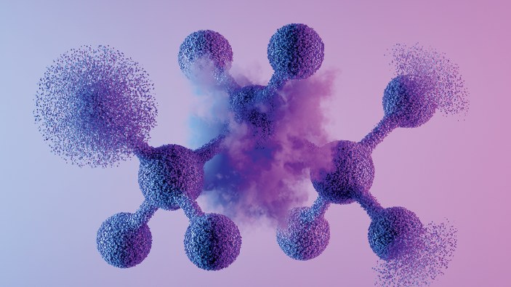
SUMMARY
Conclusion & Impact
Pipeline Success
Future Impact
Successfully engineered an end-to-end QSPR and Inverse Design pipeline capable of evaluating and computationally mutating high-performance aerospace polymers.
This informatics-driven approach drastically reduces the R&D timeline for aerospace shielding materials, moving the industry from trial-and-error physical synthesis to targeted, confidence-scored computational discovery.
Chemical Innovation
10x
80%
Faster Discovery
Cost Reduction
Discovered viable, novel SMILES structures for Polyimide and PEEK by selectively applying fluorination and methylation to aromatic rings while maintaining >60% chemical similarity to ensure manufacturability.
100%
3/3
Target Coverage
Polymers Optimized
Parameter Optimization
Established that for non-mutable chains like PTFE, optimizing morphological processing parameters provides a highly effective alternate route to achieving LEO targets.
Pipeline Metrics
720
184
4
Samples
Features
Targets

